Slide 1

ULTRASONIC SECURITY SYSTEM
IOT

Slide 2

Purpose
Providing home based security system.
Notes:
Notes to presenter:
What is your purpose for sharing this reflection?
Is it at the end of a unit or project?
Are you sharing this reflection, at the attainment of a learning goal you set for yourself?
Is it at the end of a course?
State your purpose for the reflection or even the purpose of the learning experience or learning goal. Be clear and be specific in stating your purpose.

Slide 3

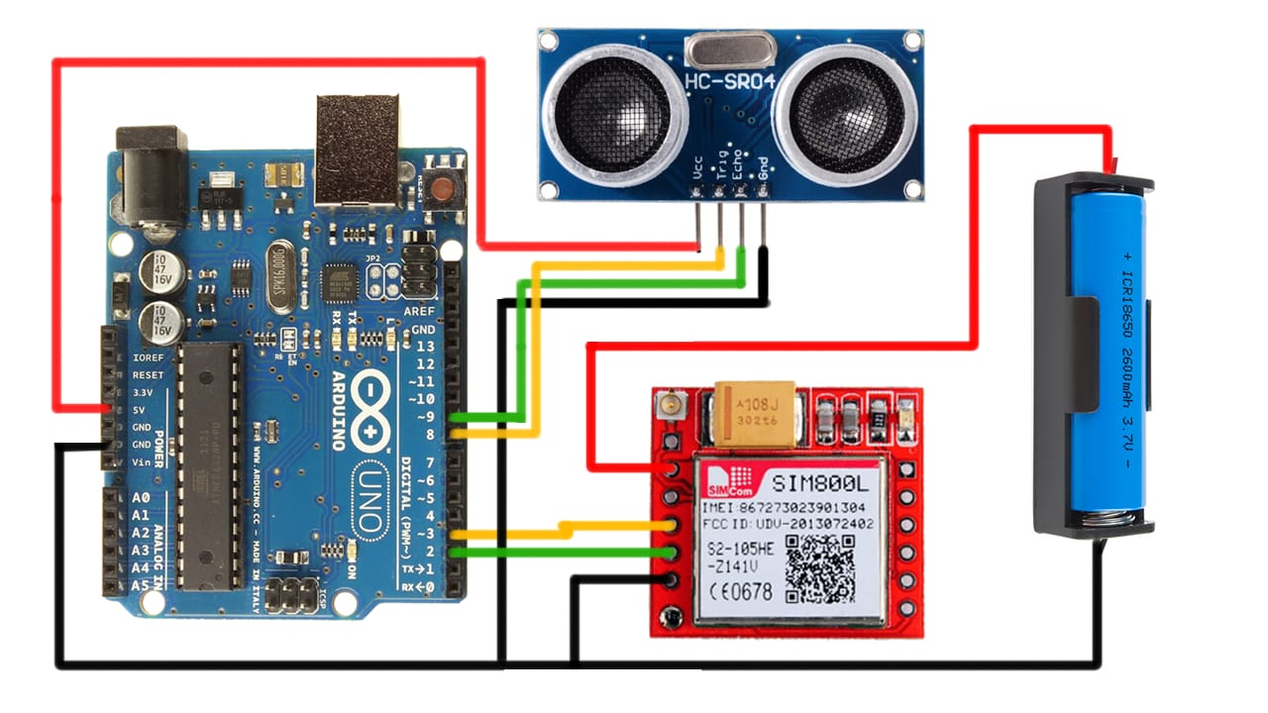
Circuit diagram
Notes:
Notes to presenter:
Description of what you learned in your own words on one side.
Include information about the topic
Details about the topic will also be helpful here.
Tell the story of your learning experience. Just like a story there should always be a beginning, middle and an end.
On the other side, you can add a graphic that provides evidence of what you learned.
Feel free to use more than one slide to reflect upon your process. It also helps to add some video of your process.

Slide 4
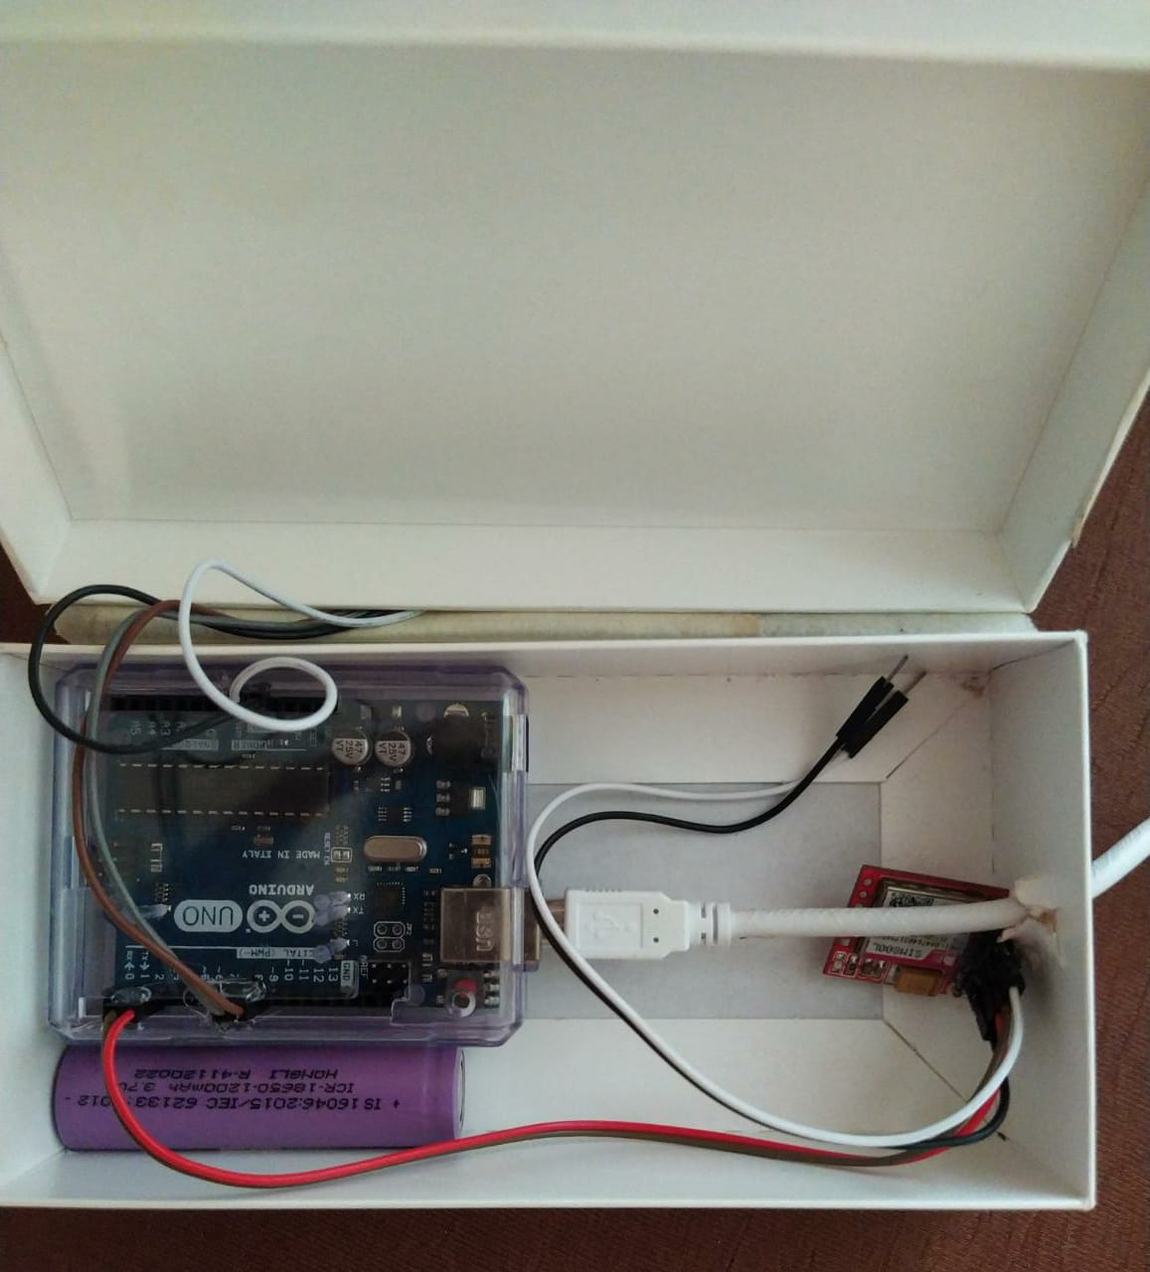
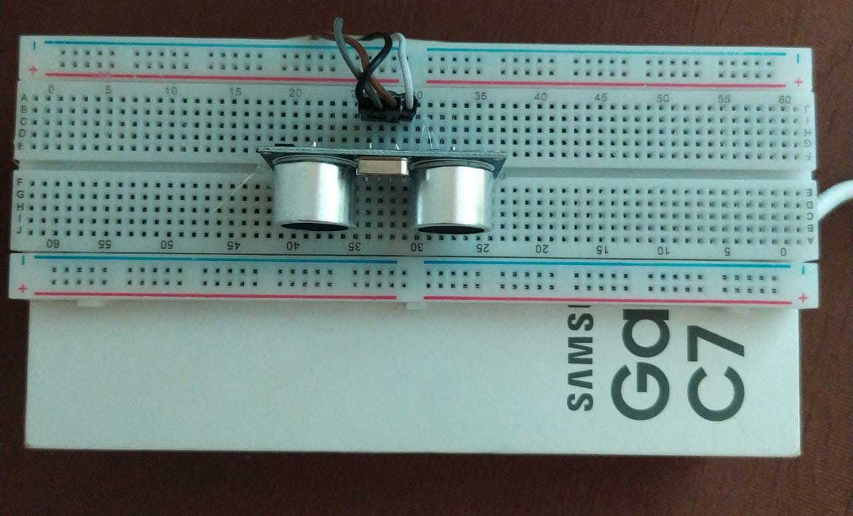
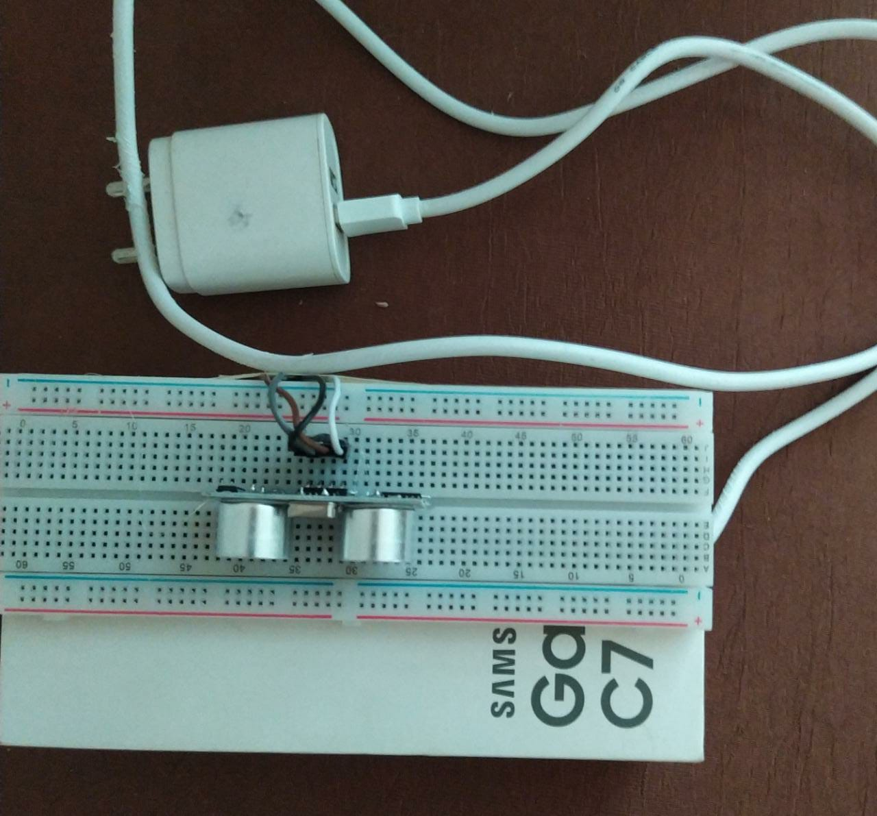
Project images
Notes:
Notes to presenter:
Description of what you learned in your own words on one side.
Include information about the topic
Details about the topic will also be helpful here.
Tell the story of your learning experience. Just like a story there should always be a beginning, middle and an end.
On the other side, you can add a graphic that provides evidence of what you learned.
Feel free to use more than one slide to reflect upon your process. It also helps to add some video of your process.

Slide 5
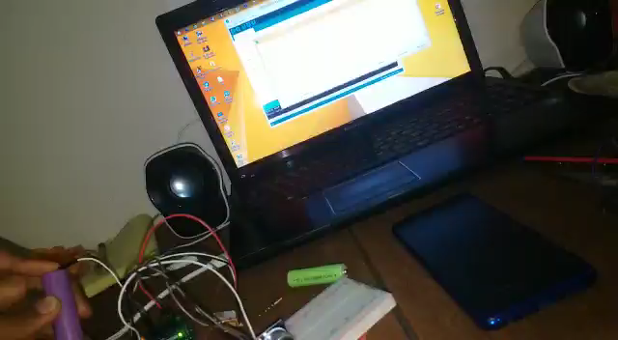
Demo
Notes:
Notes to presenter:
Description of what you learned in your own words on one side.
Include information about the topic
Details about the topic will also be helpful here.
Tell the story of your learning experience. Just like a story there should always be a beginning, middle and an end.
On the other side, you can add a graphic that provides evidence of what you learned.
Feel free to use more than one slide to reflect upon your process. It also helps to add some video of your process.

